Slide 1


Education For All
Charity
OYINLOLA, Olushola Ezekiel
SQL Capstone Project

Slide 2
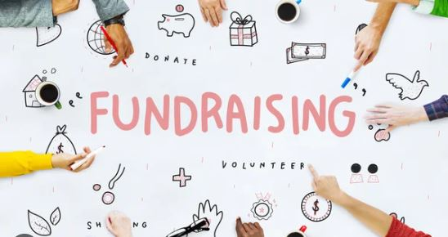
Recommendations
Education For All CHARITY
1 & 2
From this analysis, it is observed that the number of female outweighs the number of male donors by 16 females. This also reveals that the total sum of donations from male superceed that of female donors by a whooping sum of $6,171. This suggest the possibility that male earns more than female as the source below reveals; https://www.forbes.com/advisor/business/gender-pay-gap-statistics/ If more advertisement is directed to males, this will boost the total amount of donations while not also neglecting the female group.
From the analysis, approximately 83% of the donations come from high income earners who contributed above $200. In reality, study shows that low income earners gives more to charity than the high income earners: https://www.philanthropyroundtable.org/almanac/who-gives-most-to-charity/ Efforts should therefore be geared towards reaching more new high income earners for more solicitations while massive advertisements and awareness should be directed to the low income earners for more donations. It is likely that most low income earners may not be aware of the donation invitations from Education For All Charity programs.

Slide 3
Recommendations
Education For All CHARITY
3
Studies show that frequency giving can improve total donation in America https://www.classy.org/blog/upgrade-recurring-donors-frequencies-end-dates/ Donations in different time interval is a good starting point to consider comparison of the donation frequency across different segments, such as donor demographics (age, gender, location), donation channels (online, offline), or donation methods (one-time, recurring), assess the impact of donation frequency on overall fundraising efforts and organizational sustainability. Strategies to optimize donation frequency may be developed such as targeted fundraising campaigns to encourage regular giving, implementing donation matching programs, or improving donor engagement and stewardship efforts and continuously monitoring donation frequency over time and evaluate the effectiveness of optimization strategies. By systematically analyzing donation frequency, “Education For All” can gain valuable insights into donors behavior, improve fundraising strategies, and enhance their ability to achieve their mission and goals. It is observed that most are one time givers and those that never follow a particular frequency. This suggest that more promotions have to be targeted to new donors, educate those one time donors and those who never follow a pattern to develop pattern giving as frequency options can inspire some creative campaign ideas to engage the recurring donors in new ways and also improved awareness to those that were giving at regular intervals should be done frequently.

Slide 4
Recommendations
Education For All CHARITY
4 & 5
Analysis here reveals that most men working in Business Development contributes most compared to people in other fields and the least contributors come from those working in legal field. Effort should be geared at improving awareness to those working in legal field to solicit charity for the education programmes of less privileged and ensure everyone has access to sound education.
Total donation is heavy at the top 5 five States of California, Texas, Florida, New York and Virginia. This is largely attributed to the dense population of these first four states. I recommend massive awareness program and advertisement to other States like Illinois, Ohio, Georgia, North Carolina, Michigan and New Jersey as Virginia makes up to 2.5% and ranks 12th in the population distribution by States in the highlighted States according to https://www.britannica.com/topic/largest-U-S-state-by-population

Slide 5

THE END
Education For All CHARITY

